Slide 1

Hotel Cancellation
Capstone project

Slide 2
Contents
Project Background
Exploratory Data Analysis
Data Cleanse and Preprocessing
Model Implementation and Evaluation

Slide 3

Project Background
Given a customer profile, is it possible to predict whether they’re likely to cancel their upcoming bookings?
If hotels know that a customer is likely to cancel, then they can better manage their bookings and waiting list. This will lead to reduced unplanned cost which is linked to higher cancellation rate. Furthermore, they can realign their strategy to the one that addresses their market trends. Strategy could include offer special deals and discounts for flexible customers.

Slide 4
Project process
Exploratory Data Analysis
To discover underlying trend that currently exists within the dataset, including information such as customer profile.
Data Cleanse and Preprocessing
Transform raw data to a format suitable for the modelling process.
Develop Bi-Predict Model
Suitable model(s) would be selected and applied at this stage, evaluating their predictive power to detect cancellation.

Slide 5
Exploratory Data Analysis
discover underlying trend that currently exists within the dataset, including information such as customer profile.

Slide 6
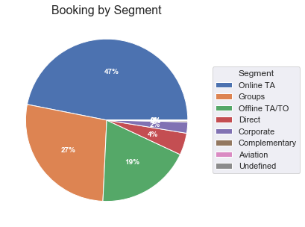
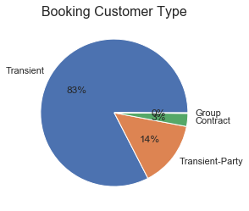
Exploratory Data Analysis bookings by segment and customer type
Online travel agent accounts for the largest segment, claiming nearly half of overall bookings. Groups and offline travel agents are the other two largest segment, accounting for 27 per cent and 19 per cent of overall bookings, respectively.
Transient customers are by far the largest customer type, with 4 out of 5 bookings being linked to this customer type.

Slide 7
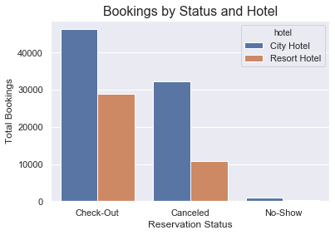
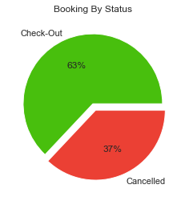
Exploratory Data Analysis bookings by status
A reasonably large proportion of bookings resulted in cancellation (37%). Majority of which were linked to City Hotel

Slide 8
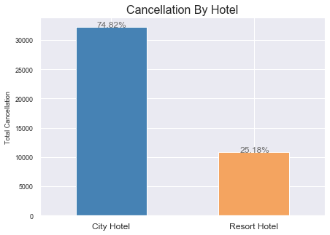
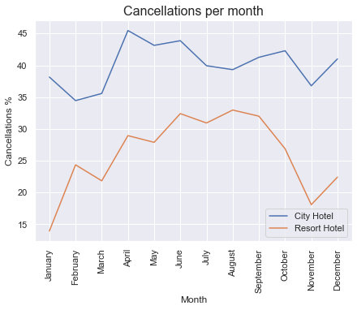
Exploratory Data Analysis cancellation breakdown
3 out of 4 cancellations are linked to City Hotel
Cancellation rate is at its peak during holiday season (between June and September) for Resort Hotel.
Whereas cancellation rate for City Hotel peaks in April, then gradually drops over the summer period.

Slide 9
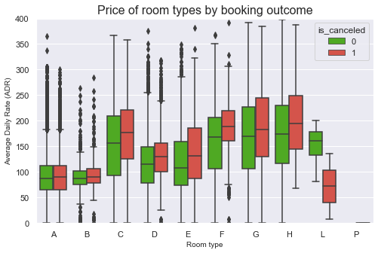
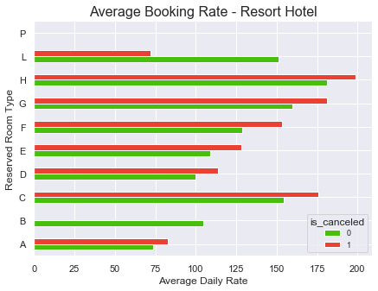
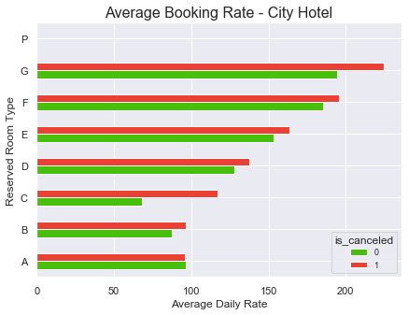
Exploratory Data Analysis booking rate & room type influence
Bookings' average daily rate appears to be higher for bookings that resulted in cancellation across all but one room type (type A for City Hotel and Type L for Resort Hotel).

Slide 10
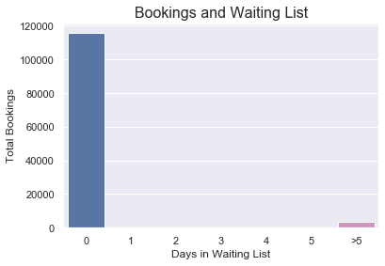
Exploratory Data Analysis bookings and waiting list
Just 3 per cent of bookings had to be placed on waiting list, with the minimum and maximum number of days in waiting list respectively being 39 and 183.

Slide 11
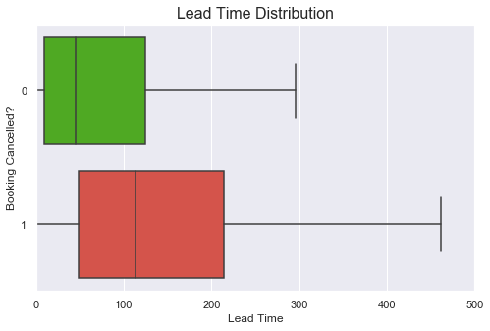
Exploratory Data Analysis lead time distribution (in days)
Lead time for cancelled booking is typically much higher compared to those of checked-in bookings.

Slide 12
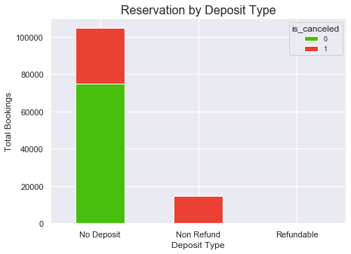
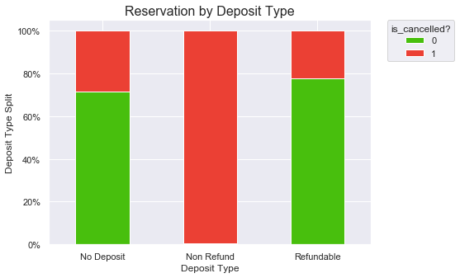
Exploratory Data Analysis BOOKINGS BY DEPOSIT TYPE
Nearly all 'Non refund' bookings result in cancellation (99.4%), Whereas, cancelled bookings account for just 28 per cent and 22 per cent of 'No deposit' and 'Refundable' booking types, respectively.
'No Deposit' booking is the most common with approx. 87% of bookings associated with this deposit type, followed by 'Non refund' with 12% of the overall bookings. Refundable booking is very uncommon with just 0.1% (or 162) of bookings linked to this deposit type.

Slide 13
DATA CLEANSE AND PREPROCESSING
Transform raw data to a suitable format for the modelling process.

Slide 14
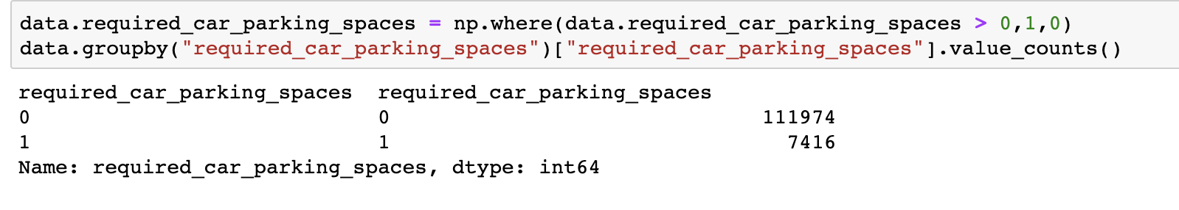
DATA CLEANSE AND PREPROCESSING dealing with outliers, missing and irrelevant values
Outliers in lead time were dealt by updating any value above 95th percentile with the cut-off (95th percentile) value.
Simplified some features by grouping their data into binary options (Y/N): e.g. parking required?
Irrelevant features (such as high % of missing data) were removed as they didn’t provide any useful information.
Created dummy variables for retained categorical data.

Slide 15
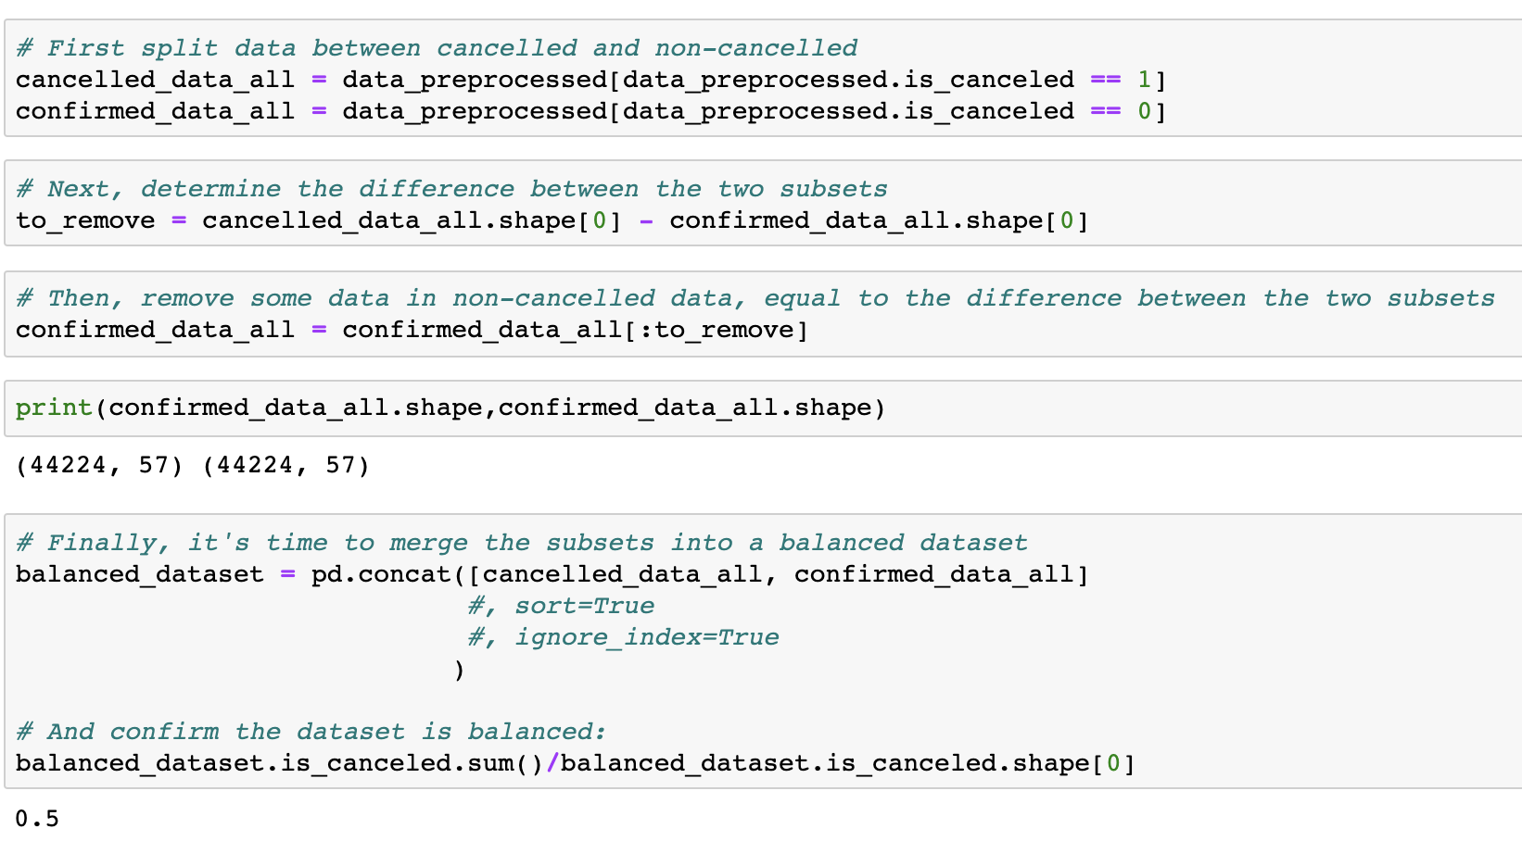
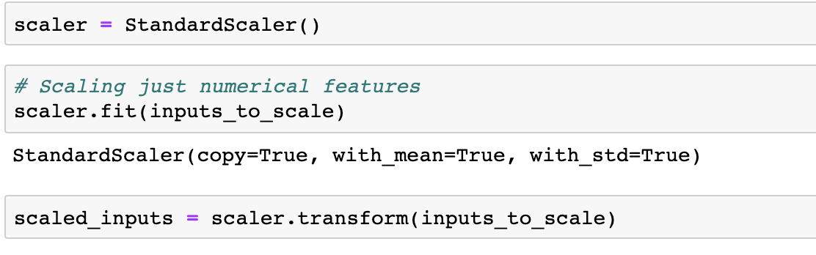
DATA CLEANSE AND PREPROCESSING balancing, standardizing & splitting dataset
Balanced the dataset, to provide even split between cancelled and non-cancelled booking data.
standardised numerical features in order to provide an similar scale across all features.
Split the data into train & test sets, then shuffled the sets in random manner.

Slide 16
Model implementation and evaluation
Suitable model(s) would be selected and applied at this stage, evaluating their predictive power to detect cancellation.

Slide 17
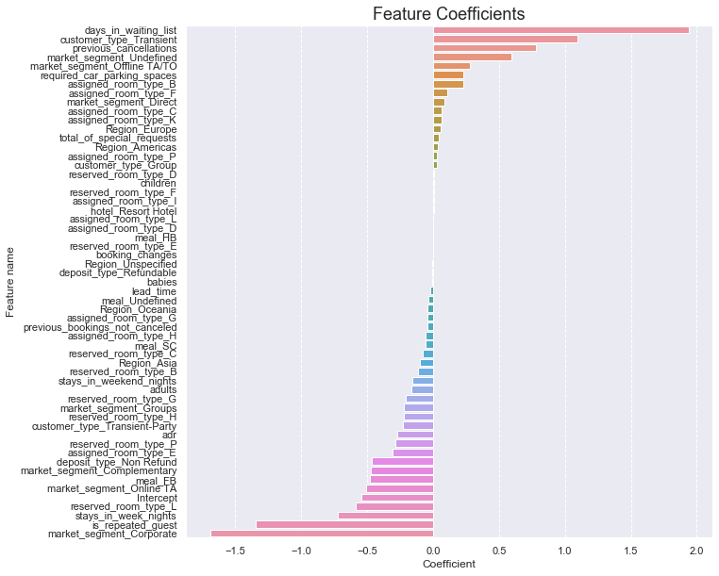
Model implementation and evaluation logistic model
Given the context of this model, the charts shows the weight/importance of each feature, with values close to 0 (regardless of being positive or negative) weighting less.
In other words, the farther the feature coefficient is from zero, the more useful the feature is to the model.
*if coefficient is around 0, then the feature will have little or no impact at all on the output, as a weight of zero implies that no matter the feature value, it will be multiplied by 0 and the whole result will be unaffected by it.

Slide 18
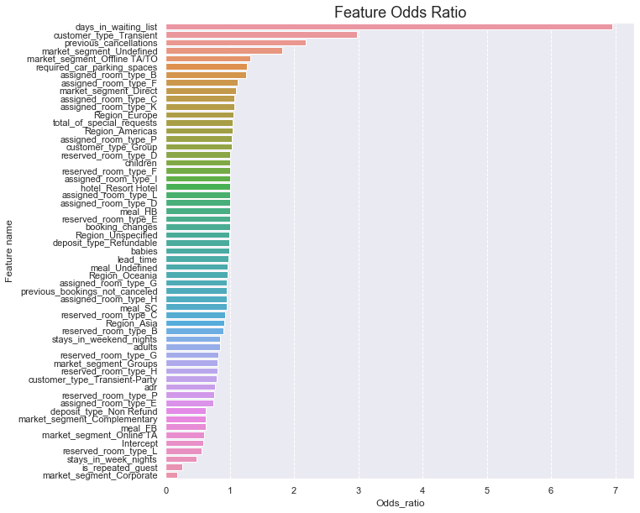
Model implementation and evaluation logistic REGRESSION – model DEVELOPMENT
Similar to coefficient, odds ratio (chart on right) shows the importance of each feature, wherein features with high odds ratio value weigh more.
The most important feature for this model is 'days spent in waiting list'. There isn't a direct interpretability of it due to the fact that it's a numerical feature that has been standardised. Its odds ratio implies that for one standardised unit or for one standard deviation increase in days spent in waiting list, it is 7 times more likely to cancel their bookings. Which isn't much of a surprise as customer could and have the option to book elsewhere.
The second most important is 'Transient customers', which is a binary feature, therefore there is a direct interpretability. Its odds ratio implies that a transient customer is approximately 3 times more likely to cancel their bookings. Again, this isn’t much of a surprise given the fact that 83% of bookings are associated to this customer type.
For bookings that include weekend stays, it can be said that for one standardised unit or for one standard deviation increase in weekend stay, the odds ratio are (1-0.85) or 15% lower than the base model (no weekend stay), i.e. less chance of cancelling. This is because of its negative coefficient value.
*if odd ratio is around 1, then the feature will have little or no impact at all on the output. This is because for one unit change in the standardized feature, the odds increase by a multiple equal to the odds ratio. So if the odds ratio is one then the odds don't change at all.

Slide 19
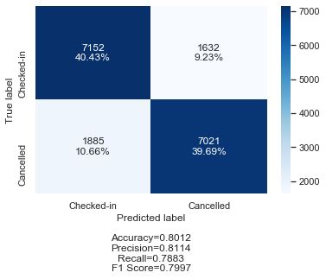
Model implementation and evaluation logistic REGRESSION – TESTING THE model
The logistic regression model has learned to accurately predict 80% of the observations. In other words, it was able to accurately determine whether a booking will eventually be cancelled in 4 out of 5 cases.

Slide 20
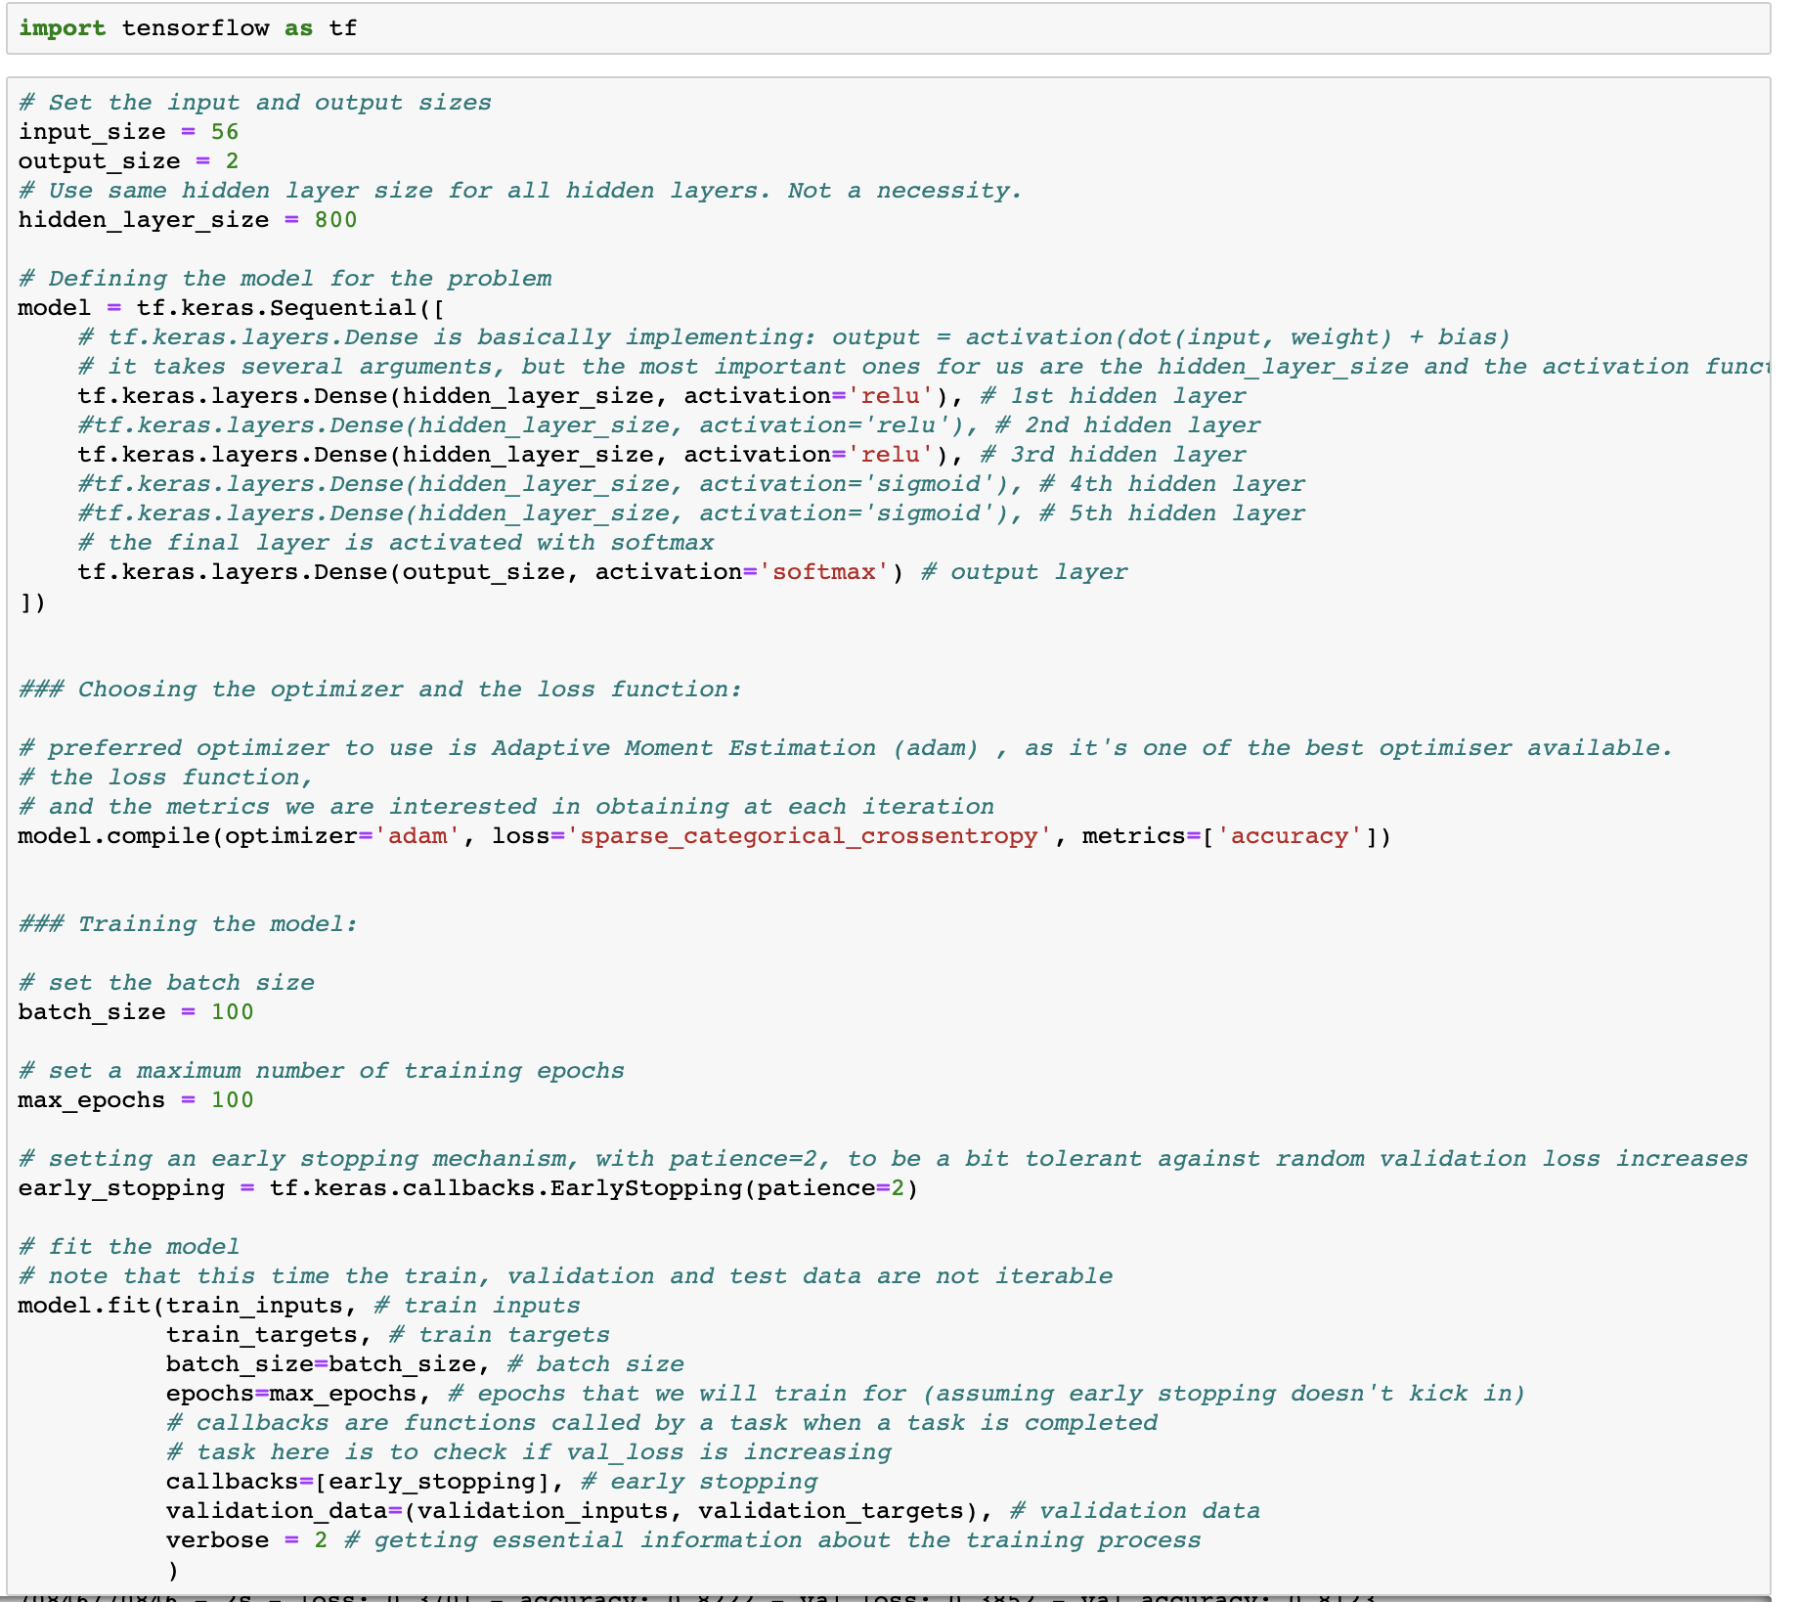
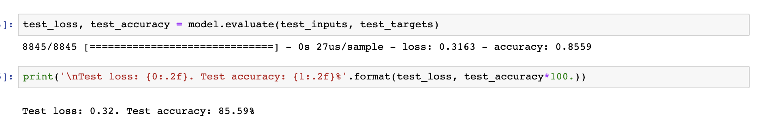
Model implementation and evaluation Neural network – TRAINING and testing THE model
Neural network was the second machine learning algorithm to be adopted for this project.
To train the neural network model to predict cancellation, the following steps were taken:
Outlined the model.
Selected optimizer and loss function.
Fitted the outlined model to the dataset.
Fine tuned/adjusted the hyperparameters of the model in order to achieved the best validation accuracy.
This was followed by testing the final prediction power of the model by fitting it on unseen (test) dataset.
The final prediction power of NN model was 85.59 per cent, which was an improvement to the logistic regression model with its final prediction power of 80.12 per cent.

Slide 21
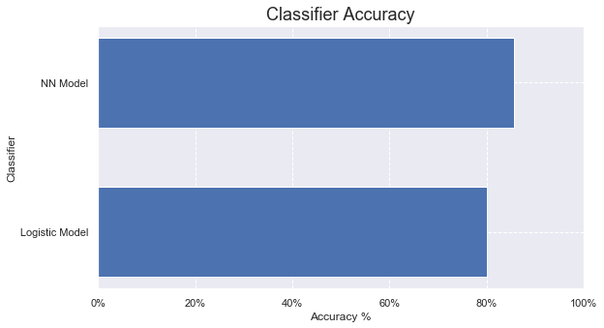
Conclusion and Final thought summary
The project began by identifying a problem/setting objective, and the objective here was to be able to predict a booking final outcome given a customer profile.
Exploratory data analysis was conducted as the first process of the project, which allowed to gain a better understanding of the data by identifying the underlying trend within the data.
This was followed by preprocessing or (feature engineering) step, with the aim of selecting appropriate features, and converting these features to a suitable format for the model(s) implementation.
The final step was to select and apply Bi-predict models suitable for the problem of this project, which were Logistic Regression and Neural Network algorithms.
The concluding observation following the application of the models in here was that Neural Network model performed slightly better in comparison to Logistic Regression model when applied to new and unseen (test) dataset, with prediction accuracy of just over 85 per cent for Neural Network, while the Logistic Regression provided a prediction accuracy of 80 per cent.

